Slide 1
Web advanced
Software

Slide 2




Notes:
*
07/16/96
*

Slide 3
Vagrant
Vagrantfile: configuratie van virtual machine
Vagrantfile
...
Vagrant.configure(VAGRANTFILE_API_VERSION) do |config|
config.vm.box = "bento/ubuntu-16.04"
config.vm.network "private_network", ip: "192.168.33.22"
config.vm.hostname = "webadv"
config.vm.provider "virtualbox" do |vb|
vb.memory = "2048"
vb.customize ["modifyvm", :id, "--cableconnected1", "on"]
end
config.vm.synced_folder "shared", "/home/vagrant/"
config.vm.provision :shell, path: "bootstrap.sh"
end
Notes:
*
07/16/96
*

Slide 4
Vagrant
bootstrap.sh: installatie (apt-get) en configuratie
bootstrap.sh
#!/bin/bash
…
apt-get update
apt-get install python-software-properties
add-apt-repository ppa:ondrej/php
apt-get -y install php7.2 libapache2-mod-php
apt-get -y install zip unzip php7.2-zip
apt-get -y install apache2
…
service apache2 restart
Notes:
*
07/16/96
*

Slide 5
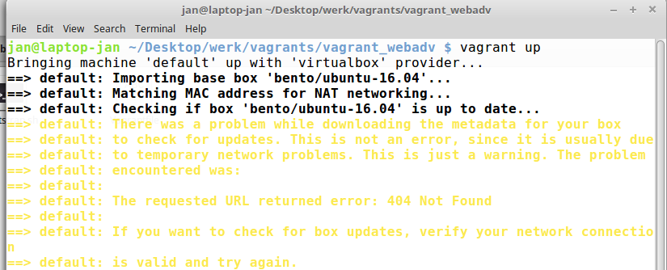
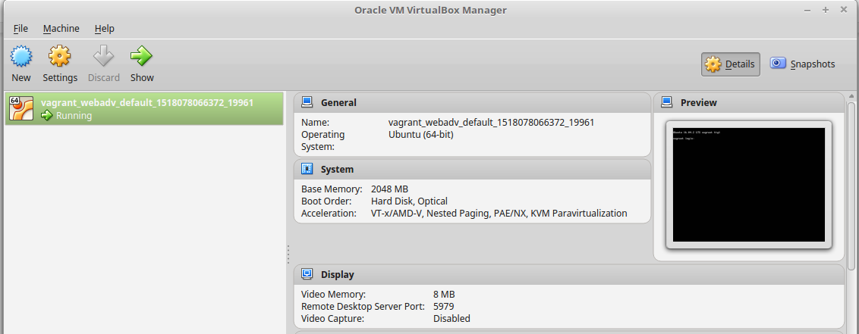
Vagrant
1e keer vagrant up : installatie (daarna: opstarten virtual machine)
Notes:
*
07/16/96
*

Slide 6
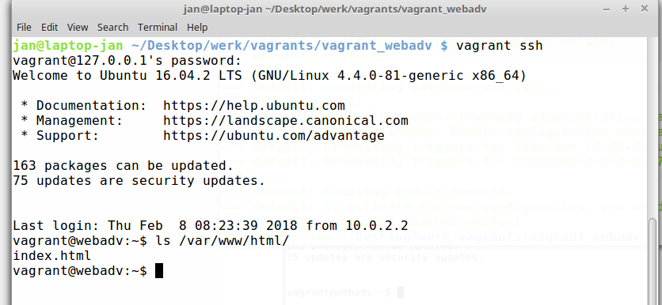
Vagrant
vagrant ssh (Windows: putty)
Notes:
*
07/16/96
*

Slide 7
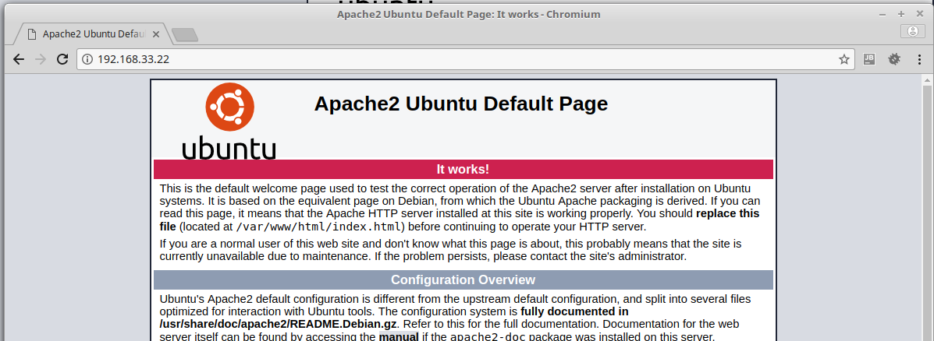
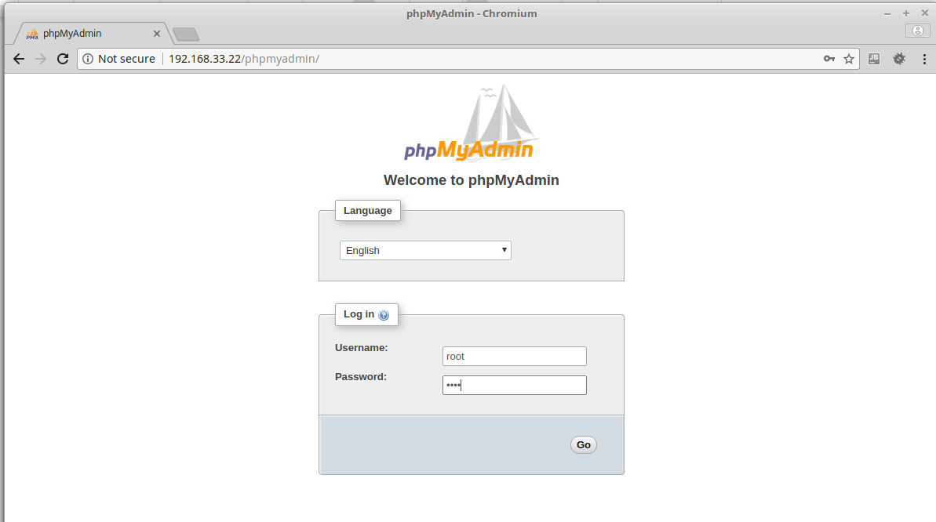
Vagrant
192.168.33.22/index.html = /var/www/html/index.html
192.168.33.22/phpmyadmin
user = root
password = root
Notes:
*
07/16/96
*

Slide 8
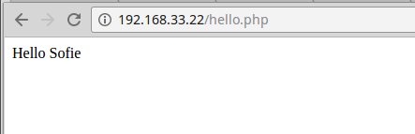
hello.php
Vagrant
<!DOCTYPE html> <html lang="en"> <head> <meta charset="UTF-8"> <title>Hello</title> </head> <body> <?php $name = 'Sofie'; print( "Hello $name\n" ); ?> </body> </html>
scp hello.php vagrant@192.168.33.22:/var/www/html
Notes:
*
07/16/96
*

Slide 9
Vagrant
Problemen:
Virtual box werkt niet samen met Hyper-V
Windows: Hyper-V aan/af
https://unclassified.software/en/apps/hypervswitch
VMWare ondersteuning is betalend in Vagrant
zelf Ubuntu server installeren met daarop SSH-daemon
bootstrap.sh kopiëren naar server en uitvoeren
sudo su -
bash bootstrap.sh
Notes:
*
07/16/96
*

Slide 10
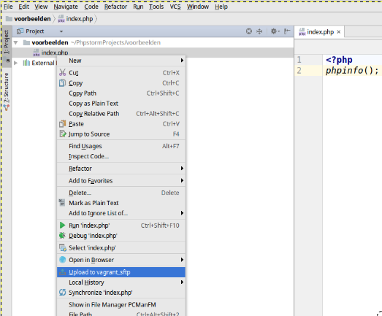
Phpstorm
Notes:
*
07/16/96
*

Slide 11
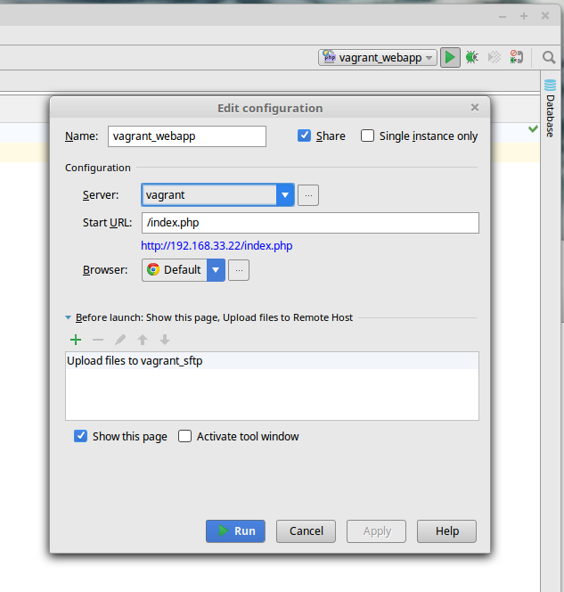
Phpstorm
Notes:
*
07/16/96
*

